Slide 1
Today
SWBAT: Compare and contrast how different economic systems address key economic factors.

Slide 2
Why does Chief Seattle consider it strange that the American government would want to buy the land on which the tribe is living? What is his view of this land?
How do you think a person in the Navajo culture attains status? How does this compare to how someone in our society attains status?
What is the relationship of the people with natural resources?
Why do you think subsistence economies have historically been unable to cope well with being geographically displaced, e.g. being put on reservations far from their original homes?

Slide 3
What was Marx reacting to when he was creating his idea for the communist society?
List the main characteristics of a socialist economy.
What do you think might be sacrificed in the economy of Marx in order to achieve more equality?
Do you think it is possible to create a more equal society where individuals still have a great deal of freedom and self-determination?

Slide 4
According to Adam Smith, what is the main thing that individuals should be concerned about in order to make society run smoothly?
Do you agree that people act mainly in their own interest? Do you think this is human nature?
What are the main characteristics of a capitalist economy?
How do you think Adam Smith would view the large corporations of the modern world?

Slide 5

ECONOMIC SYSTEMS
Command vs. Market

Slide 6

WHAT DO THE FOLLOWING HAVE IN COMMON?
Basketball Team
Flea Market
Human Body
Assembly Line
Governments
Telephones

Slide 7

SYSTEM
a group of individual parts that work together to form a whole
What are the different “parts” of the economy?

Slide 8
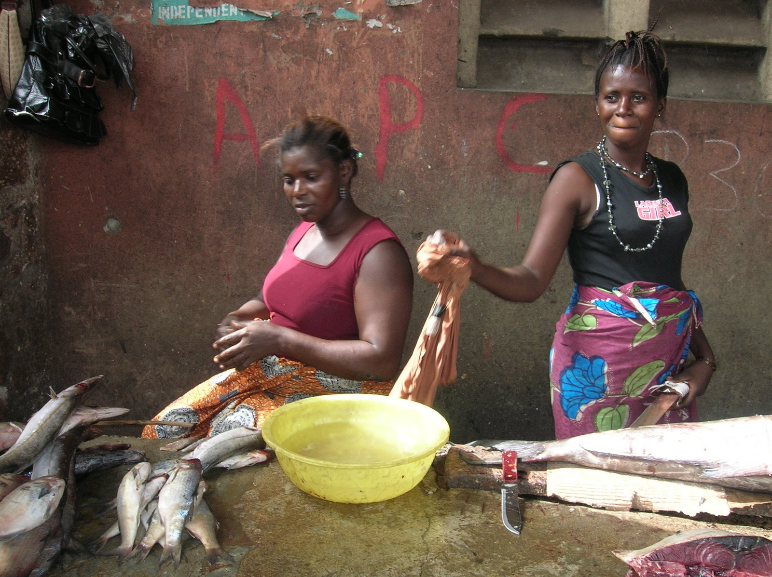
Traditional Economic System (C1)
Examples- Eskimos, the Island of Mocha, Amish

Slide 9
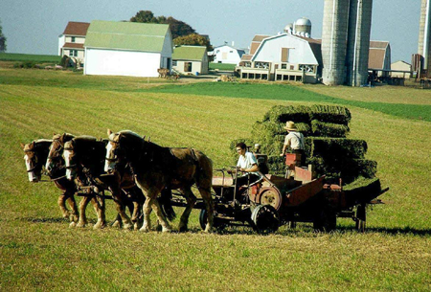
Traditional Economic System (C2)
Mainly a gathering, fishing or hunting society.
No Technology
Very family oriented

Slide 10
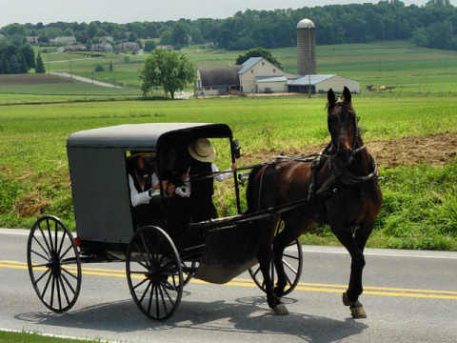
Traditional Economy (C3)
They answer the three basic economic questions by customs.
How ever they did it in the past they will do it in the future.

Slide 11
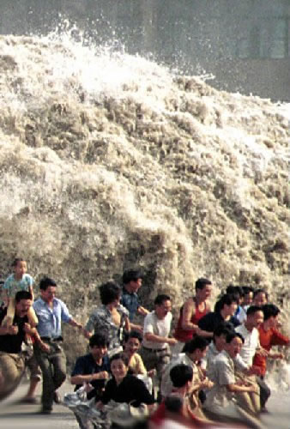
Traditional Economic System (C4)
No innovation
No Technology
One natural disaster from extinction
Why can’t they move to another location if there is a natural disaster?

Slide 12



MARKET ECONOMY (C1)
  system in which private individuals control the means of production.
  United States, England, France etc.

Slide 13
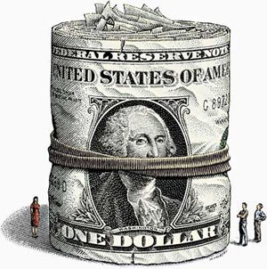
Market Economy (C2)
Competition
Mass Production
Consumer Sovereignty
Supply and Demand
Free Enterprise
Profit Motive
Private ownership
Incentives
Mainly in Democracies of some sort.

Slide 14

Market Economy (C3)
Business owners answer the questions What?, How?, and For Whom?
Supply and Demand
Very little Government intervention.

Slide 15
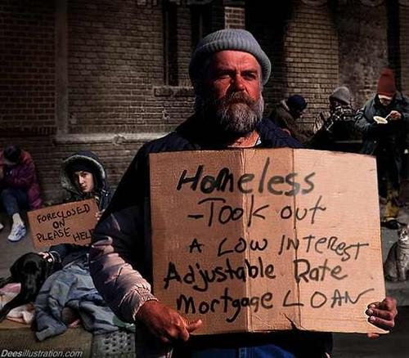
Capitalism (C4)
Builds a Class System
The Have’s vs. The Have Not’s
Crime

Slide 16
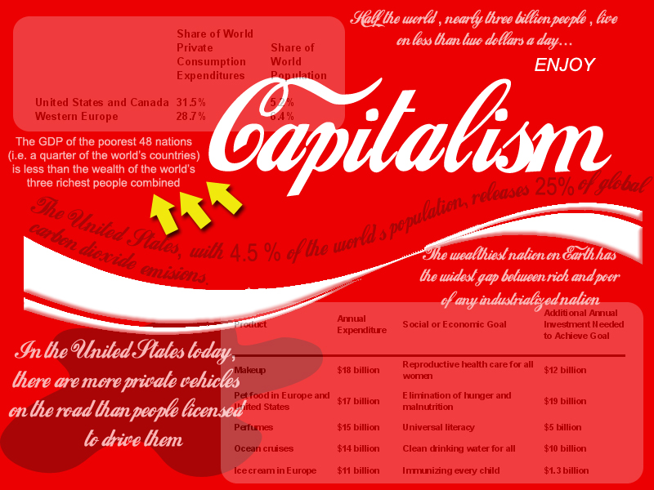
Capitalism (C5)
CAPITALISM
Laissez-faire
Adam Smith : Book Wealth of Nations
Invisible hand (Supply and Demand)

Slide 17

COMMAND ECONOMY (C1)
  A system in which private individuals have little control over the means of production. The government has all economic power
  China, Cuba and the former Soviet Union

Slide 18
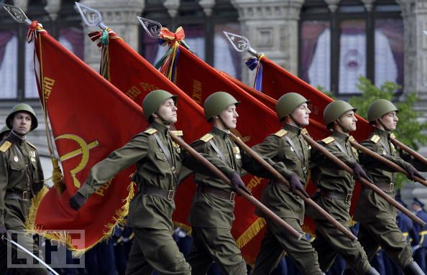
Command Economic System (C2)
Government owns all resources.
The people all work for equal benefits.
The people are all equal.
Supply = Demand (Gov’t Decisions)
No class system
No crime

Slide 19

Command Economy (C3)
    The Government answer the questions What?, How?, and For Whom?
    Dictatorships and Totalitarian forms of government are most prevalent in command economies.

Slide 20
Command Economy- (C4)
Supply does not always equal demand (Shortages)
Very Little Choice for consumers
The government gets rich
No Profit Motive
Lack of incentives

Slide 21
Command Economy (C5)
COMMUNISM AND SOCIALISM-examples of a command economy
Karl Marx- Father of Communism wrote the Communist Manifesto. He hated Capitalism- Thought that it created to big of a gap between rich and poor.
Communism would stop crime

Slide 22
MIXED ECONOMY
  Mixed Economy-have elements of both command and market economies.
Most countries including the U.S. are mixed

Slide 23
Which of the following would apply to market economy?
A. The government puts in strict regulations to protect the consumer.
Businesses an consumers are free to make their own choice.
Taxes are paid by businesses to help pay for government programs.
All of the above.
35

Slide 24
Who developed the theory of capitalism?
Adam Smith
John Locke
James Madison
Karl Marx
35

Slide 25
Which of the following BEST describes a traditional economy?
Buyers have many choices in the market.
The economy is based on the “way things have always been done.”
The government keeps the profit made by business.
There are more sellers than buyers.
35

Slide 26
Which of the following BEST describes why countries are interdependent (trade with other countries )societies?
No country can survive on its own because of lack of resources.
Countries must trade to fulfill their wants and needs.
Many countries need the assistance of larger countries to stay strong.
All of the above.
35

Slide 27
Which of the following BEST describes the study of economics?
The study of how individuals make choices in a world of scarce resources.
The study of how businesses make a profit.
The study of how household’s make budgets.
The study of how government’s control the money supply.
35

Slide 28
Why is profit so important in a capitalist economy?
  It is the major incentive for starting a business.
  Without profit, a business can’t pay off its expenses.
  Profit is what business owners use to pay their rent or mortgage.
  None of the above.
35

Slide 29
Many countries in Europe follow a ___________ system in which the government has a great deal of control, but the people benefit from the various social programs.
  capitalist
  socialist
  fascist
  communist
35

Slide 30
Capitalism is an example of a ___________ economy.
  command
  mixed
  traditional
  market
35

Slide 31
Which of the following is NOT a basic question answered by an economic system?
  What should be produced?
  Where the good should be produced?
  How should the good be produced?
  For whom should the good be produced?
35

Slide 32
In an capitalist economy, it is difficult to allocate resources evenly because:
  Resources are scarce and the government is not allowed resources to be sold.
  Resources are scarce and the government controls all of the means of production.
  Resources are scarce and a few people control all of them.
  Resources are scarce and people with more money are better able to attain them
35

Slide 33
Which goes with which?
Market economy and Karl Marx
Command economy and capitalism.
Market Economy and a Democracy
Command Economy and Democracy
35

Slide 34
Which of the following is MOST LIKELY to be a condition of a command economy?
system
model
industry
Government allocation of resources
35

Slide 35
A set of rules that help a nation decide how to best distribute its resources to satisfy people’s wants and needs.
system
model
industry
allocation of resources
35

Slide 36
Which would be a characteristic of a market economy?
Government control
Shortages
Profit motive
A lack of incentives
Totalitarian Government
35

Slide 37
Which goes with which?
Market economy and Karl Marx
Command economy and communism.
Market Economy and a Dictatorship
Command Economy and Democracy
35

Slide 38
COMMAND OR MARKET: place the following in the Venn Diagram
1. A man gets a loan from a bank and opens his own business.
2. The government heavily taxes business owners.
3. The government offers welfare programs to help the people.
4. There is a big gap between the rich and poor because people have the chance to make money.
5. The government makes most of the decisions about the economy.
6. The economy is driven by people making choices for themselves.
7. People are motivated by the fact they can keep all the profit they make from their business.
8. The government tries to close the gap between the rich and the poor.
9. The government regulates businesses so they do no rip off consumers.

