Slide 1
Goal 9 (with worksheet)

Slide 2
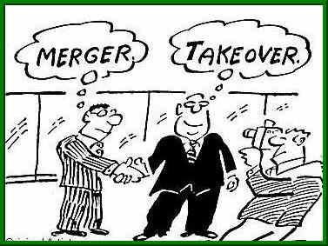
Combinations and Mergers
Synonym meaning when companies join together.
Vertical combination and Horizontal combination.
Combinations can create monopolies
It is bad for the consumer because it

Slide 3
Vertical mergers vs Horizontal mergers
Glaxo
Glaxo Smith
Glaxo Smith kline
Wachovia
Wells Fargo
Toys R Us
Toy middle man
Toy distribution company.

Slide 4
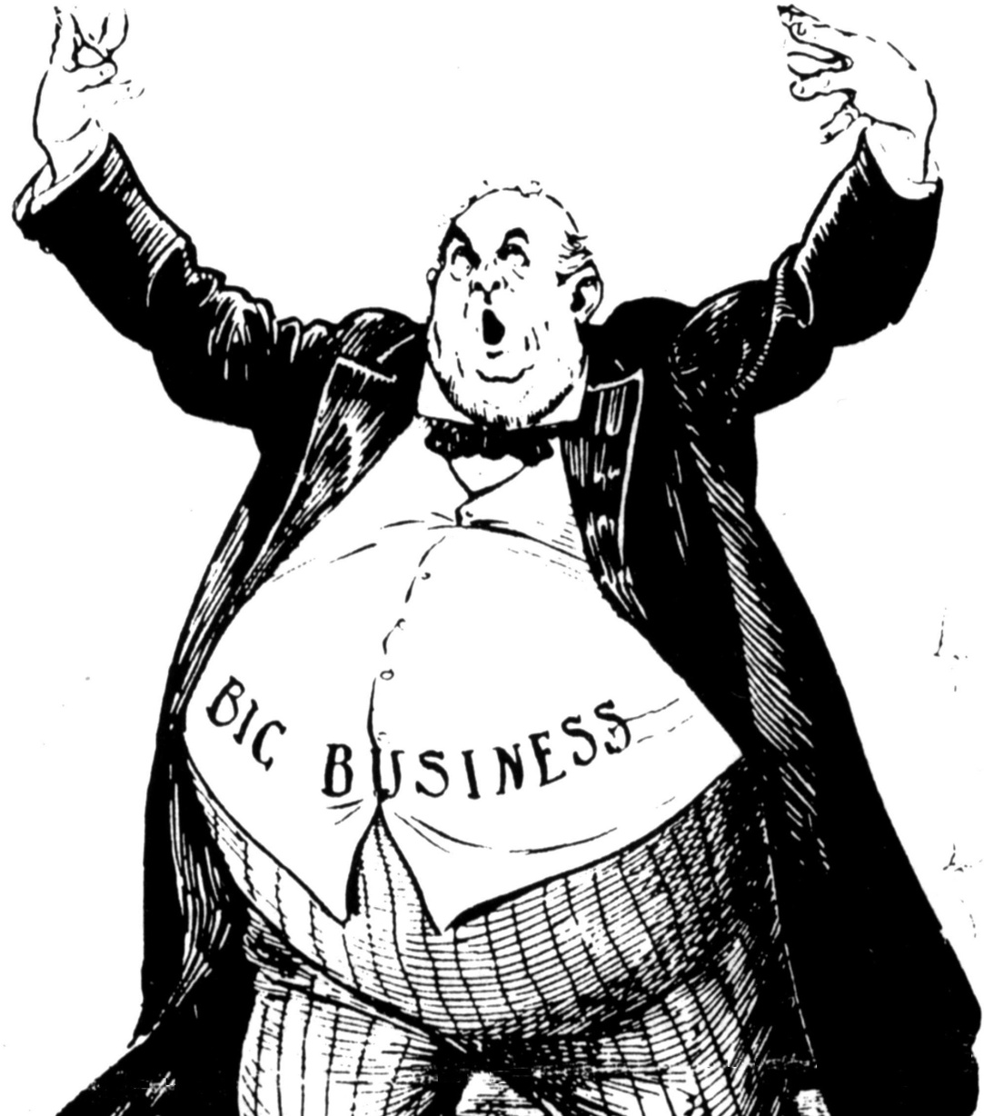
What can combinations create?
Monopolies

Slide 5
Why is this bad for the consumer?
The customer loses control:
Producers will increase price
Give less quantity
Less quality

Slide 6
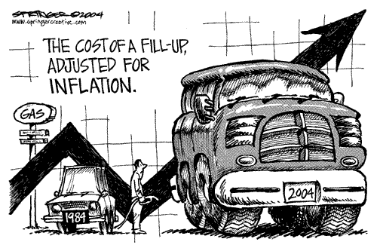
What is inflation?
Annual Increase in Prices
Caused by increase in salaries (we spend more)
Increase of the cost of the 4 factors of production

Slide 7
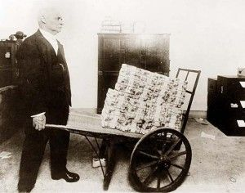
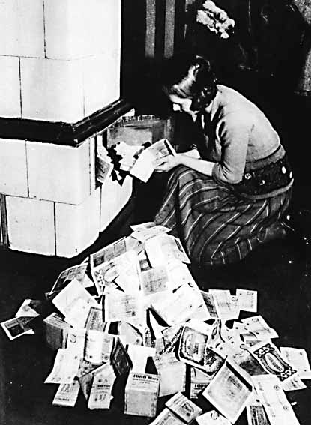
Hyperinflation

Slide 8
What is deflation?
The decrease in prices

Slide 9
How can inflation have a negative impact on the economy?
Prices rise leaving less money in the pocketbook/wallet

Slide 10
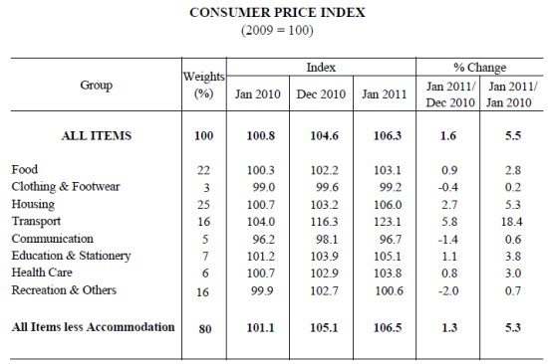
How does the consumer price index help measure the inflation rate? 4 complete sentences
The consumer price index is an average of changes that occur over time in prices paid for by consumers for goods and services. It used as an indicator of how the economy is doing and is used for the adjustment of the value of the dollar.

Slide 11
8. How does the Consumer Price Index help measure the economy?
CPI is an index of 400 products that we can measure.
1985- Movies 3.00, Gas- 1.00, HD TV 25,000
2018- Movies 10.50, Gas- 2.50, HD TV 450.00
There is a formula so you can see how much inflation has occurred from a base year to any year.

Slide 12
You need to know that the consumer price index
Measures the inflation rate.

Slide 13
Remember:
Nominal Rate is anything that has not been adjusted for inflation.
Nominal GDP
Nominal Wage Rate
Real is any number
Real GDP
Real Wage Rate

Slide 14
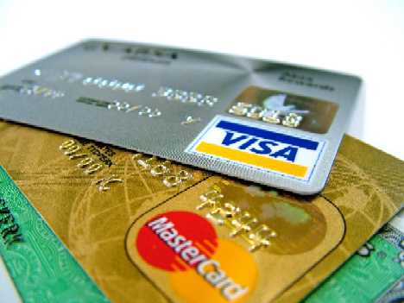
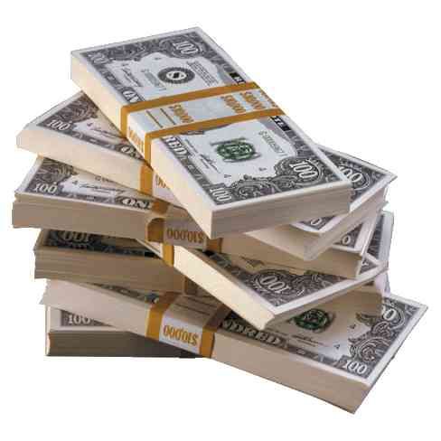
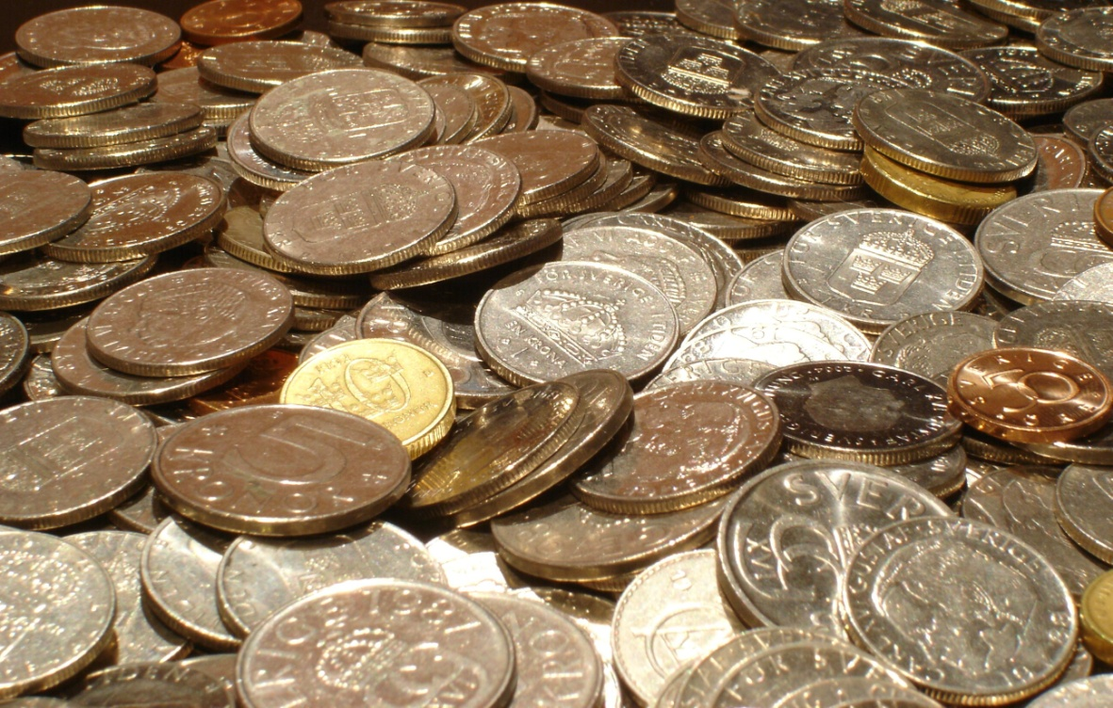
Two Types of Money
Coins
Currency (Dollar)
Credit Cards (high interest)
Debit Cards (Directly from your account)

Slide 15
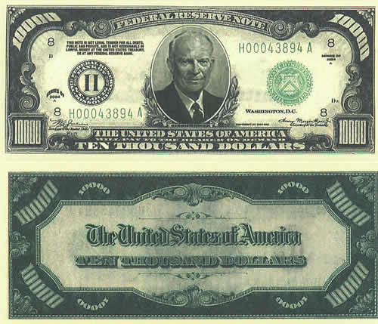
11. What gives our FIAT money value?
Money is not backed by gold or silver
Money is not made of any thing of value
So, Why is it valuable.
Because our Government says so. The government backs our dollar bill.

Slide 16
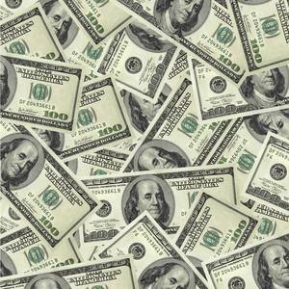
Money
Functions of Money:
Money is a medium of exchange
Money is a measure of value
Money is a store of value

Slide 17
Characteristics of Money:
Money must be accepted
Money must be divisible
Money must be portable
Money must be stable

Slide 18
What are the two types of money?
Fiat Money: Money that has value because someone said so.

Slide 19
FDIC
Federal Deposit Insurance Corporation
Guarantees your deposit up to 100,000.

Slide 20
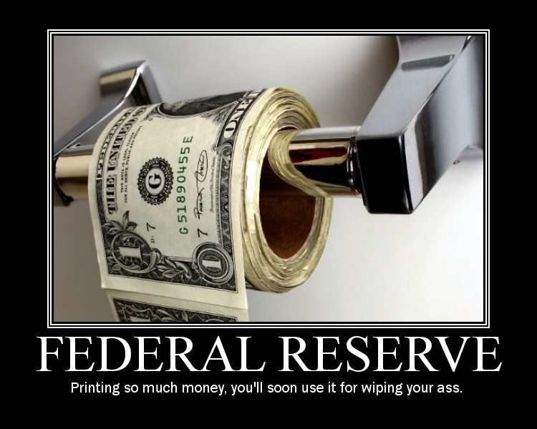
What is the Federal Reserve System?
The Central bank for the United States.
Known as the FED.

Slide 21
The main job of the FED
To loan banks money.
Keep the monetary supply in balance.

Slide 22
The FED as a Regulator
To control the money supply
They oversee and regulate the commercial banks.
Wells Fargo and Wachovia.
There job is to keep competition at a good level.

Slide 23
Monetary Policy
Controlling the money supply and cost (interest rate) of borrowing money.
Monetary (% supply)Policy.
Fiscal Policy- Manipulation through taxes

Slide 24
How money Grows.
You make a 1000.00 deposit
Your bank account is credited.
The bank must keep a reserve requirement in the vault of 10%.
The bank will loan out the other 90%

Slide 25
Growth of money
$1000.00 deposit- RR$100- Loan out $900
$900.00 deposit- RR $90- Loan out $810
$810.00 deposit- RR $81- Loan out $729
$729.00 deposit- RR $73- Loan out $656
$656.00 deposit- RR$ 66- Loan out $590
$590.00 deposit- RR$ 59- Loan out $531
And so on
So, the 1000.00 deposit grew 4216.00

Slide 26
Money supply
If the money supply grows to fast we have high inflation.
If the money supply grows to slow then we have deflation.

Slide 27
The economy is built on confidence
If everyone feels great about the economy then we spend and the economy works great.
If we are not confident then we begin to hoard our money. This creates slowdowns for businesses, unemployment and the down turn in our economy.

Slide 28
3 tools by the FED. A. Discount Rate
Discount rate is the interest rate given to banks for their money.
If the FED increases the Discount Rate they are shrinking the money supply.
If the FED decreases the Discount Rate they are enlarging the money supply.

Slide 29
3 tools by the FED. B. Reserve Requirement
Reserve Requirement is what the banks must keep in the vault from every deposit.
If the FED increases the Reserve Requirement they are shrinking the money supply.
If the FED decreases the Reserve Requirement they are enlarging the money supply.

Slide 30
3 tools by the FED. C. Open Market Operations
Open market operations is how the Government sells US treasury bonds
If the FED increases the interest rate (payback) on the bones they are enlarging the money supply.
If the FED decreases the interest rate on the bonds they are shrinking the money supply.

Slide 31
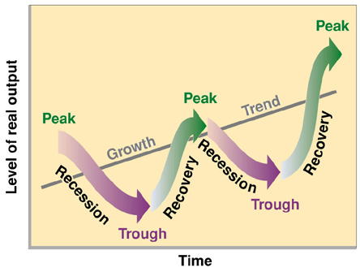
The business Cycle
Inflation is the increase in prices annually
Deflation is the decrease in prices (very bad).
If inflation grows to quickly then eventually we will not be able to keep up.

