Slide 1
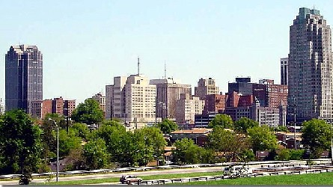
LOCAL GOVERNMENT
What is the purpose?

Slide 2
TWO TYPES OF LOCAL GOVERNMENT
Municipalities: city, town, or village governments
  WAKE COUNTY has 11 municipalities: Raleigh, Garner, Cary, Apex, Fuquay-Varina, Knightdale, Wendell, Zebulon, Morrisville, Holly Springs, Wake Forest-Rolesville.
  More than 540 in NC
The city where the courthouse is located is known as the COUNTY SEAT…in Wake County’s case this is Raleigh.
Everyone lives in a county but not a municipality

Slide 3
TWO TYPES OF LOCAL GOVERNMENT
Counties: A large territory and political subdivision in a state
North Carolina has 100 counties
  In Alaska counties are called boroughs, in Louisiana parishes
Example: Wake, Johnston, Durham, Franklin

Slide 4

Local Government
  LOCAL GOVERNMENTS ONLY HAVE LEGISLATIVE AND EXECUTIVE BRANCHES…
  -The courts are run by the state government
  -cities can make ordinances (local laws) but state courts punish law breakers

Slide 5
Municipal Government
Municipalities are incorporated (legally included or added) within counties because people living there desire an even more localized provision of public services and decision-making
Must be incorporated by the General Assembly, which defines the geographic boundaries of the municipality and approves its charter.
The charter may call the municipality a city, a town, or a village
  in North Carolina, these terms carry no special legal meaning and are not tied to the population

Slide 6
Short local Government Video
http://www.sog.unc.edu/sites/www.sog.unc.edu/files/unmanaged/LGNC/Xerte/chapter_1/index.htm

Slide 7
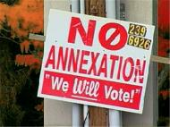
Annexation
Bringing unincorporated areas into city or town limits
  Usually for the purpose of using city utilities such as water and trash pick-up

Slide 8
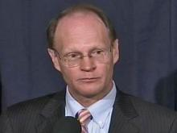
WHO RUNS LOCAL GOVERNMENTS?
MUNICIPALITIES:- Set up in several different ways depending on the town or city; can have a city council, town council, board of commissioners, and/or alderman
  Raleigh have a City Council (elected by the people) -Raleigh has a mayor (elected by the people)
  The mayor is on the city council
  Mayor
  Charles Meeker

Slide 9
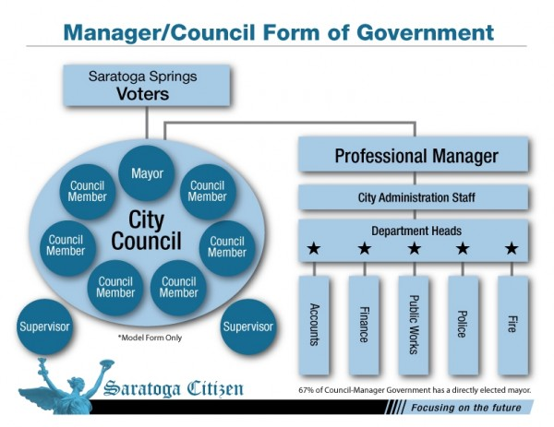
Council-Manager Form
Council-Manager Form
  This form is used for some cities and all counties
  Elected council & mayor make laws
  Appointed manager handles day-to-day business

Slide 10
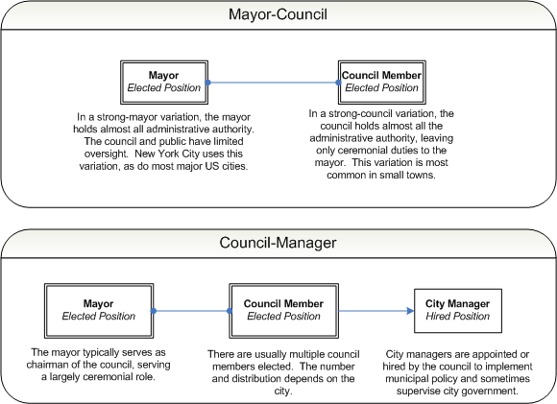

Slide 11
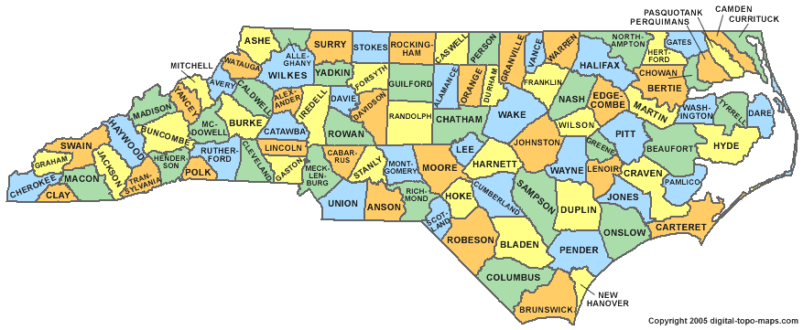
North Carolina Counties

Slide 12
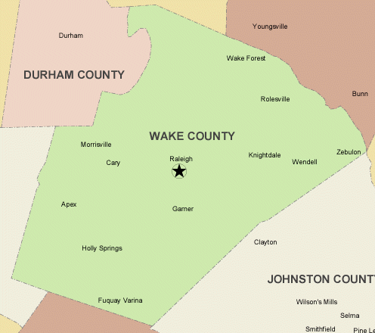
WAKE COUNTY MUNICIPALITIES

Slide 13
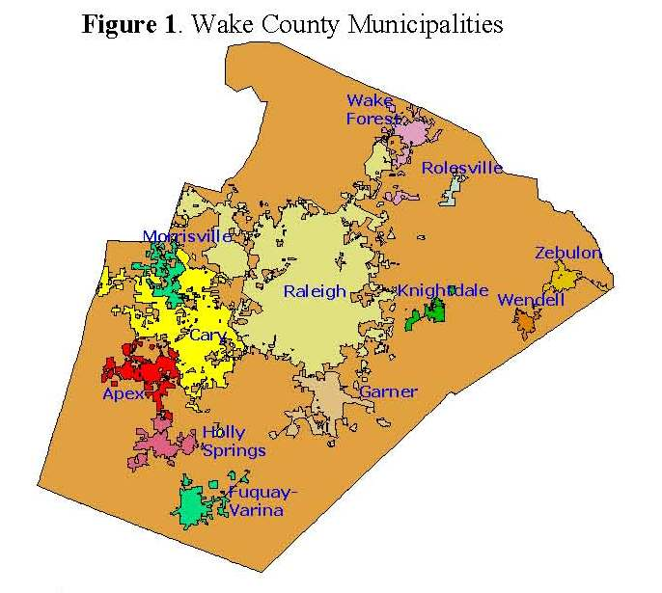
Wake County

Slide 14
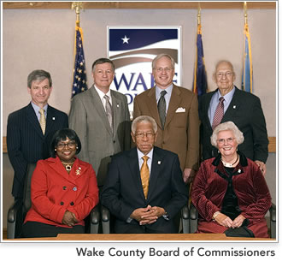
WHO RUNS LOCAL GOVERNMENTS?
COUNTIES: Run by a Board of Commissioners
1. Make and carry out decisions for the county
2. Have the authority to tax (property tax and sales tax)
3. Manage the county budget (give money to the local school boards)

Slide 15


Slide 16



Slide 17
Annexation
Bringing unincorporated areas into city or town limits
  Usually for the purpose of using city utilities such as water and trash pick-up

Slide 18

Local Government
Local governments raise money through taxes:
  Property taxes, public utility taxes, sales taxes
  This is called REVENUE

Slide 19


Local Government
Local governments spend money on services such as:
  Schools, law enforcement, public utilities (water, trash pick-up)
  This is called EXPENDITURES

Slide 20
Municipal government services
Municipal governments often provide the same types of services as counties, such as water supply, wastewater treatment, police and fire protection, garbage collection, planning and zoning, and building inspection.
Some municipalities operate additional services, such as airports, auditoriums, bus systems, cemeteries, electric or gas systems, parks and recreation programs, public housing, and traffic control.
*Oftentimes, counties and municipalities will work together to coordinate for the most efficient provision of services.

Slide 21

PUBLIC EDUCATION
  This is the responsibility of both state and local governments
    STATE-sets qualifications for teachers, develops curriculum, sets base salaries, and graduation requirements

Slide 22

PUBLIC EDUCATION
    LEA- Local Educational Agency (SCHOOL BOARD)-sets school calendar and attendance policies, can supplement teacher pay, pays for school buildings and maintenance, decides how to meet state requirements

Slide 23

  Who pays for public education?
    SCHOOL BOARDS CANNOT TAX-depend on county commissioners to levy local taxes
    INTERGOVERNMENTAL REVENUE-money taken from the state and federal government (mostly state)
**Federal government usually gives grants for specific programs.

Slide 24
LAW ENFORCEMENT
  The General Assembly makes laws, but most enforcement is handled by the local government.
    MUNICIPAL POLICE (Raleigh Police, Cary Police)-handle law enforcement in their municipality
    SHERIFF’S OFFICE-operates county jails, regulate courts, deliver subpoenas and court papers
  STATE HIGHWAY PATROL-regulates highways in the state
**STATE AND LOCAL OFFICIALS WORK CLOSELY TOGETHER

Slide 25
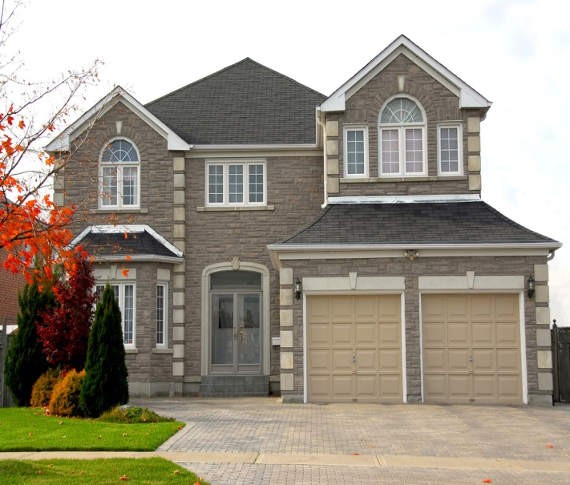
LAND USE
LAND USE
  Local governments regulate how land is used to protect the environment, protect health and safety, to protect property values.

Slide 26
LAND USE
    ZONING-designating certain areas for certain kinds of land use.
EX- housing, business, parks, trash dumps, factories etc.
**MUST HAVE A PERMIT BEFORE YOU BUILD ON AND PIECE OF LAND-even if you own it!!!!!
    Builders must follow certain rules and codes for safety-must be inspected.

Slide 27
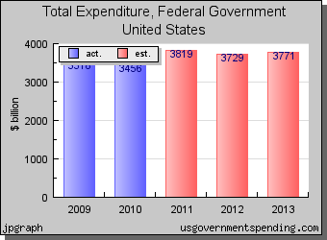
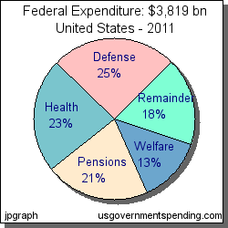

Slide 28
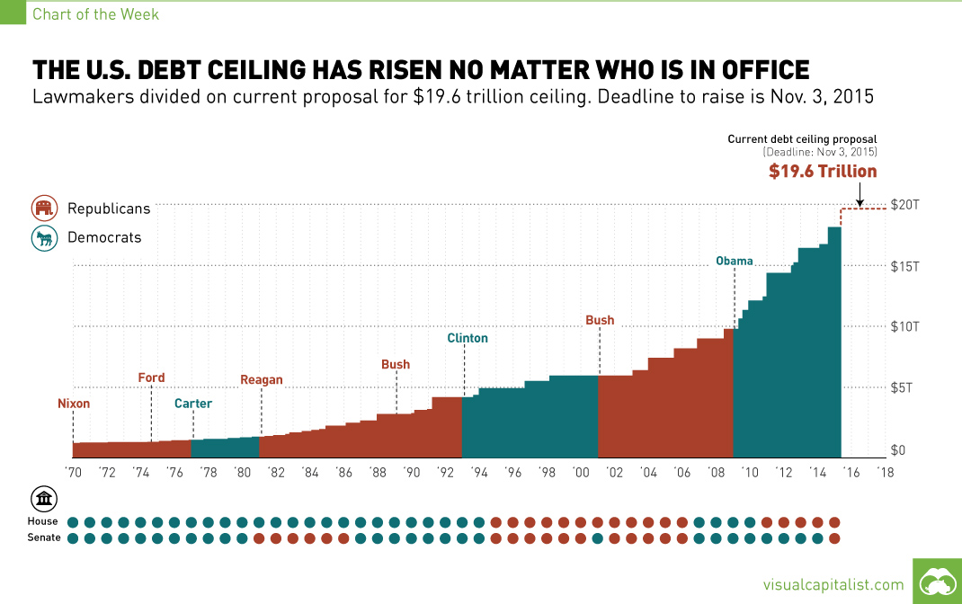

Slide 29
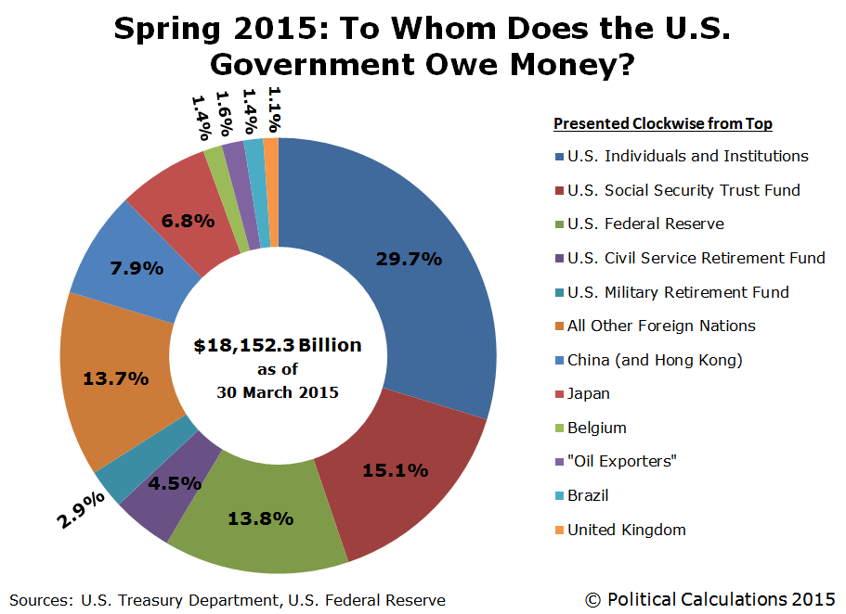

Slide 30
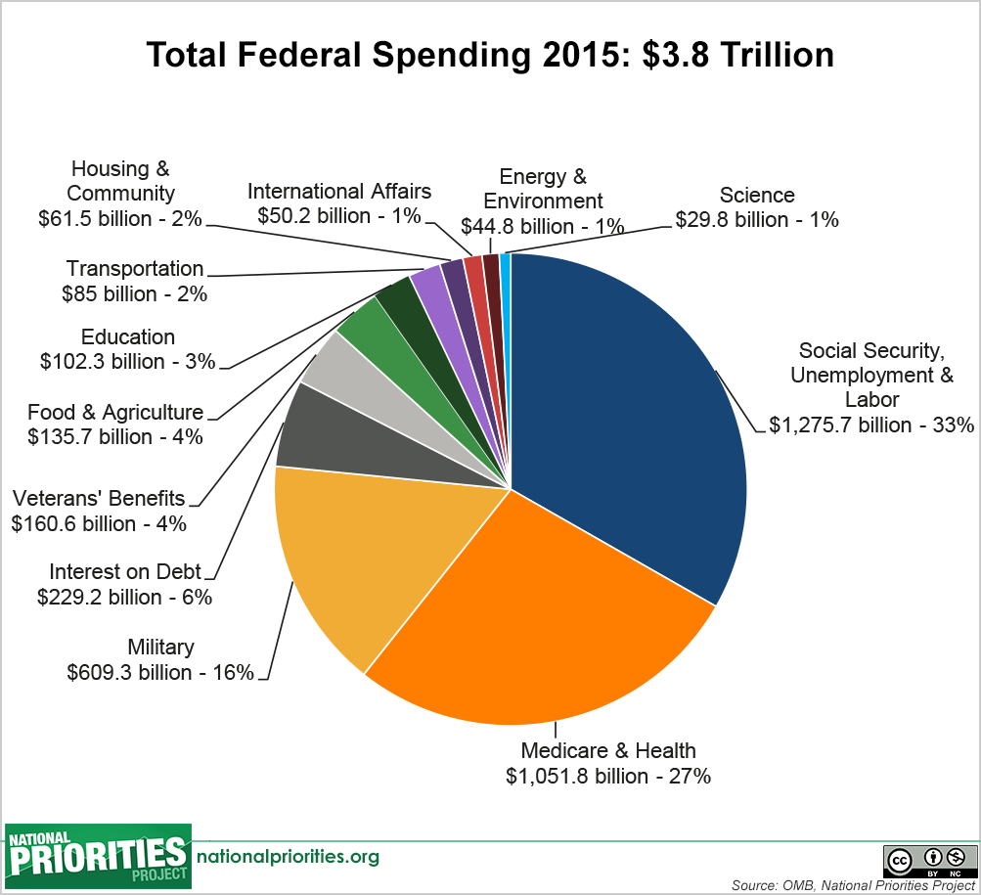

Slide 31
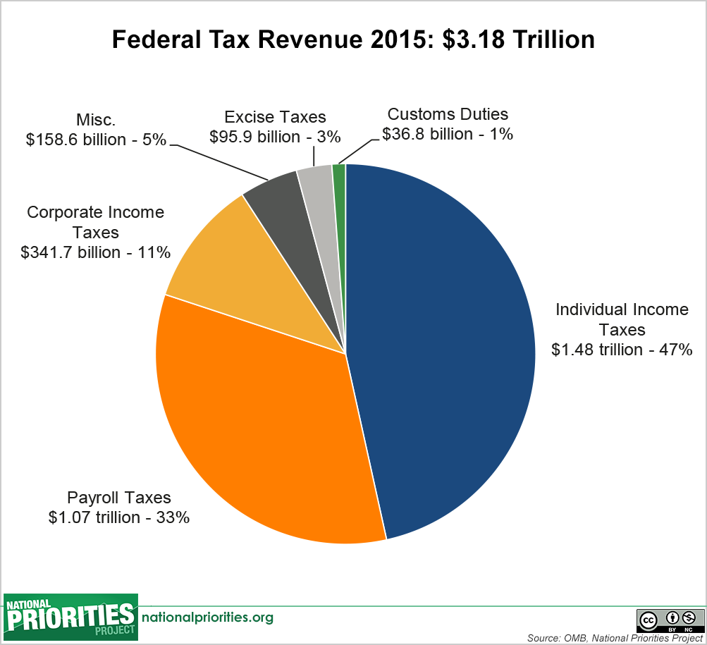

Slide 32
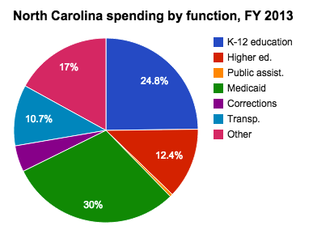

Slide 33
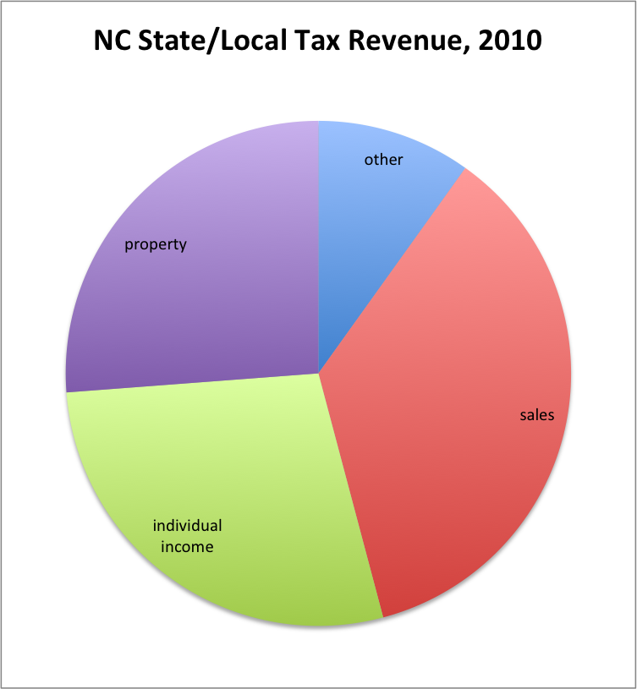

Slide 34
